Slide 1
LLM-Assisted Data Extraction
DSC 360 Building AI-Powered Applications
Fall 2025

Slide 2
Introduction

Slide 3
Why This Matters
Unstructured text →
Structured JSON →
Validated Data →
SQL Database →
LLM-Powered Applications

Slide 4
Why This Matters
Every modern RAG/agentic system rests on structured data.
Lab 5 teaches how to extract, validate, and store that structure.
Lab 6 will build safe querying on top of that foundation.
Lab 7 will incorporate agentic iteration.
You’re becoming the engineer in the loop —
designing how an LLM talks to data safely!

Slide 5
Structured Outputs from LLMs

Slide 6
Version 1
Naïve “string” parsing
  resp = chat(
  model="gemma3:2b",
  messages=[{"role":"user",
  "content":"Extract ticker and price: Paid $12.50 for AAPL"}])
  print(resp["message"]["content"])
Evaluation: It’s inconsistent.
  Sometimes "AAPL 12.50", sometimes words, sometimes nothing!
Moral: natural-language output is not machine-readable.

Slide 7
Version 2: Ask for JSON
  prompt = """Return ONLY valid JSON:
  {"ticker":"AAPL","price":12.50}"""
  resp = chat(model="gemma3:2b",
  messages=[{"role":"user","content":prompt}],
  options={"temperature":0.0})
  print(resp["message"]["content"])
Evaluation: Better
  Mostly JSON, but still fragile (missing quotes, code fences).

Slide 8
Version 3
Structured Outputs + Validation
Define schema
  Python class (extends Pydantic BaseModel)
  The class defines the desired output format exactly
Call model with schema enforcement
  format=schema
  Pydantic confirms types and constraints
If invalid, try to coerce or re-ask LLM or inform human in the loop

Slide 9
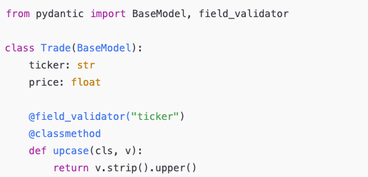
Step 1: Define schema

Slide 10
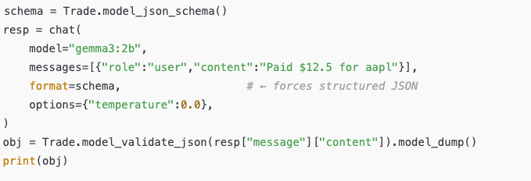
Step 2: Call model with schema enforcement
Notes:
Discuss what happens:
format=schema tells the LLM to stay within the JSON schema.
Pydantic confirms types and constraints.
If invalid → ValidationError → we can attempt a coercion step or re-ask.

Slide 11
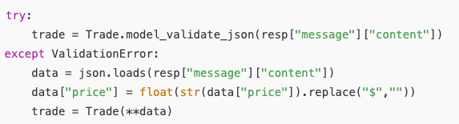
Step 3: Try to recover from minor errors

Slide 12
Takeaway
Structured outputs
+
schema validation
=
unit tests baked into your pipeline!

Slide 13
Bridge Concepts

Slide 14
Earlier Skill
Cleaning CSVs
Regex
Pandas DataFrame
Type hints
New Concept
Validating JSON
Schema-guided parsing
SQL tables
Runtime validation
Notes:
Pydantic functions like runtime type checking + validation.
In production, this is the backbone of safe LLM apps.

Slide 15
Databases and SQL

Slide 16
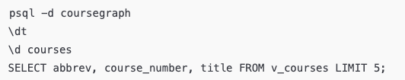
Quick psql demo
PostgreSQL
  Tables are strongly-typed containers for our validated data.
  We’ll now insert our clean JSON objects into sections, courses, etc.
  Later (Lab 6) we’ll add embeddings and safe SQL query generation.

Slide 17
Roadmap
How the CourseGraph Labs Fit Together
And then … build a mini-capstone that extends this pattern!
Lab | Title | Core Idea
5 | LLM-Assisted Extraction | Structured outputs → validated SQL inserts
6 | Safe Natural-Language Queries | Read-only SQL, embeddings, injection defense
7 | Agentic Reasoning | Planning, tool use, and synthesis

Slide 18
Lab 5 Walkthrough

Slide 19
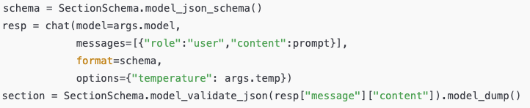
Task 1: Ingest the Schedule
Goal: parse each line into validated JSON (SectionSchema).
Key call:
Run (safe preview):
  python3 src/lab5_task1_ingest_sections.py --program DSC --limit 5 --dry-run --verbose --temp 0.0

Slide 20
Task 2: Prerequisite Logic
Goal: convert text like
“DSC 230 or permission of instructor”
→ {"dnf":[["DSC230"],["permission"]]}

Slide 21
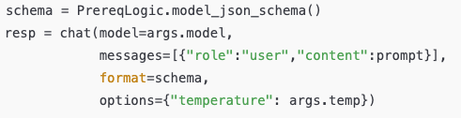
Task 2: Prerequisite Logic
LLM call now uses:
Validate + normalize: ensure AND/OR structure, uppercase codes
Run:
  python3 src/lab5_task2_prereqs.py --program DSC
  --limit 5 --dry-run --verbose --temp 0.0

Slide 22
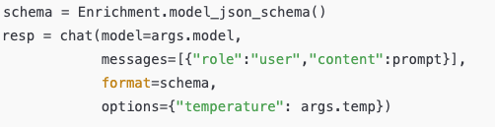
Task 3: Semantic Enrichment
Goal: extract skills, modalities, audience from descriptions.
LLM call:
Validate + backfill baseline to ensure every row has something.
Run:
  python3 src/lab5_task3_enrich_descriptions.py --program DSC
  --limit 5 --dry-run --verbose --temp 0.0

Slide 23
Wednesday Preview

Slide 24
Safety and Reliability Preview
Risk | Mitigation
Model drifts from format | format=schema + Pydantic validation
Hallucinated columns | SQL whitelist (Lab 6)
Prompt injection | Guardrails in system prompt
Bad values | Coercion → re-validation loop
Engineers design safe failure modes —
you can recover, log, or reject.

